Slide 1
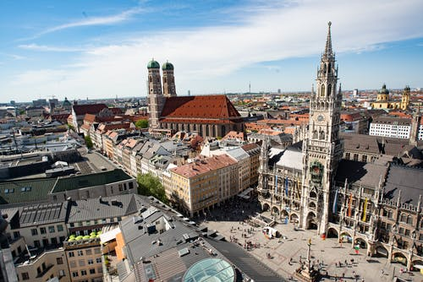
Find the right Place for an organic supermarket in Munich
DR. E. WESNER

Slide 2
Introduction
Description & Disscusion of the Background
Why Munich?
With 1.5 million inhabitants, Munich is only the third largest city in Germany, but the one with the highest population density, with 4777 inhabitants per square kilometer. As a resident of this city, I decided to use Munich in my project. The city is divided into 55 neighborhoods in total in an area of 310 km².[1]
Aim of the study
With my data analysis I would like to support someone who wants to open an organic supermarket in Munich. With the analysis of the venues in Munich I would like to find districts in which cultural facilities or restaurants are less available but sports facilities, playgrounds and food shopping facilities are more represented. However, the number of organic supermarkets should be low in these areas to have as little competitors as possible. Since a supermarket needs a relatively large area to operate, I use the rent index to find areas where rents are not as high. In areas with middle rents the customer group is suspected to be found, as in areas with low rents, people are suspected to by not organic food.

Slide 3
Data Description
I found the postal codes of Germany from Suche-Postleitzahl.org [2]. The .geojson file has coordinates of the postal codes of Germany. I had to clean the data and reduce it to the city of Munich.
For the neighborhoods of Munich I fount the rent index at [3]. At Wikipedia the assignment of the postal codes to the neighborhoods I could find. [4]. To show the rent index on a choroplethmap of Munich I had to combine the postal codes with the rent index.
With geopy/geocoder I managed to get the central coordinates of the neighborhoods. [5]
I used Foursquare API to get the most common venues of given neighborhoods of Munich [6].
By using kMeans I wanted to cluster the neighborhoods to find ones where the people live and cultural facilities are less available.
If numbers of organic groceries are not available at Foursquare I got them from a phonebook. [7]
Finally I give an overview on the data by a map and graphics on Clusters, Rent index and counts of organic supermarkets in the neighborhoods.

Slide 4
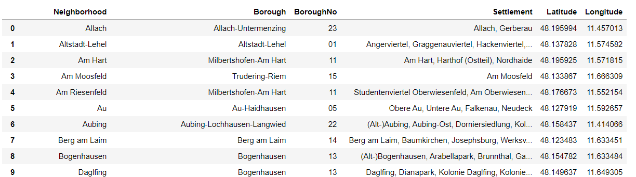
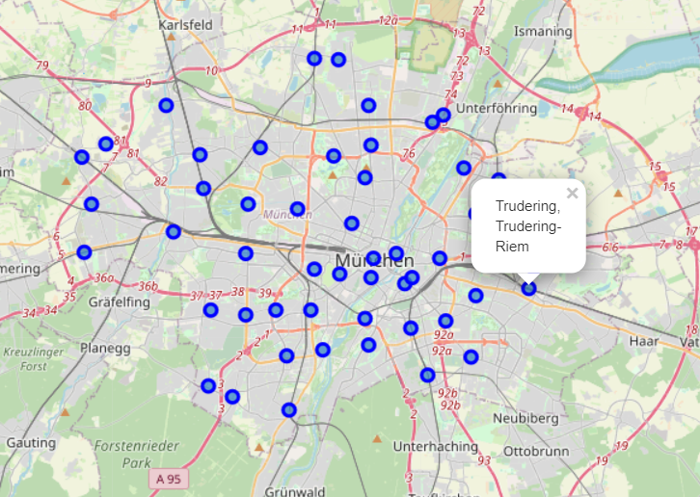
Neighborhoods with geocoordinates
I started with an overview on the Munich neighborhoods on Wikipedia. With geopy/geocoder I managed to get the geocoordinates of the centers of each neighborhood
The distribution of the Neighborhoods on a choropleth map

Slide 5
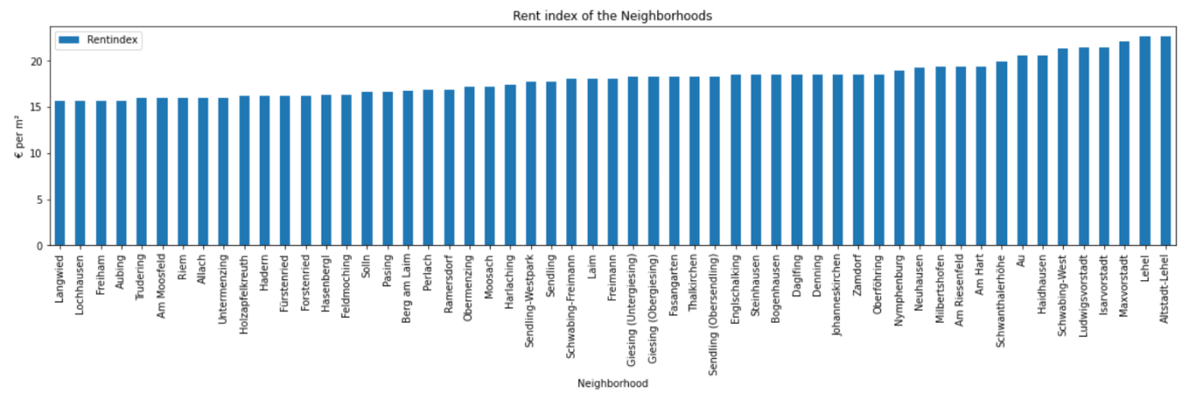
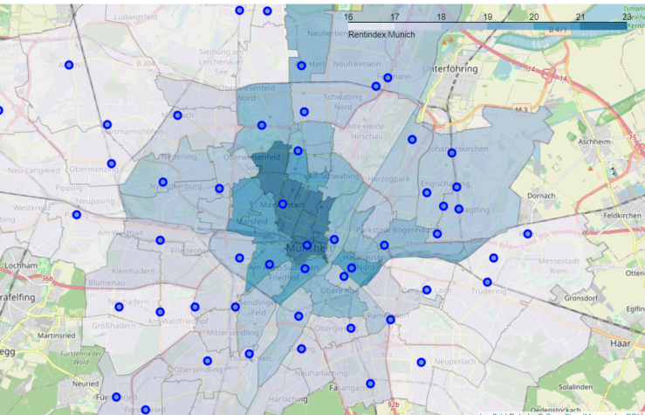
Rentindex for Munich
For the neighborhoods I found the rent index as a graphical presentation. The rents in Munich are high, from 16 to 22 €/m².
With the use of a json-file containing the geospatial data of the postal codes of Munich, I managed to show the geographical distribution of the rents.

Slide 6
Venues of Munich
With the geodata of the Neighborhoods I used the Foursquare API to get the Venues in the Radius of 1 km of the center of the Neighborhoods. With the API I got 2543 Venues.
I reduced the categories of the venues for example by excluding the restaurants and summerised physical health concerning venues or all theaters.
The reduction of the venue categories led to a meaningful clustering. Optimal clustering with 3 clusters resulted in the following with the most common venues.
Clusters | 1st common venue | 2nd common venue | 3rd common venue
No. 0 red | Coffee, Hotel | Bar, Shop, Physical Health | Plaza, Bar, Coffee
No 1 purple | Bus stop, Market, Physical Health, Coffee, Hotel | Bus stop, Market, Bakery | Market, Shop, Hotel
No 2 green | Physical Health, Bakery | Market, Physical Health, Coffee, Shop | Drugstore, Physical Health

Slide 7
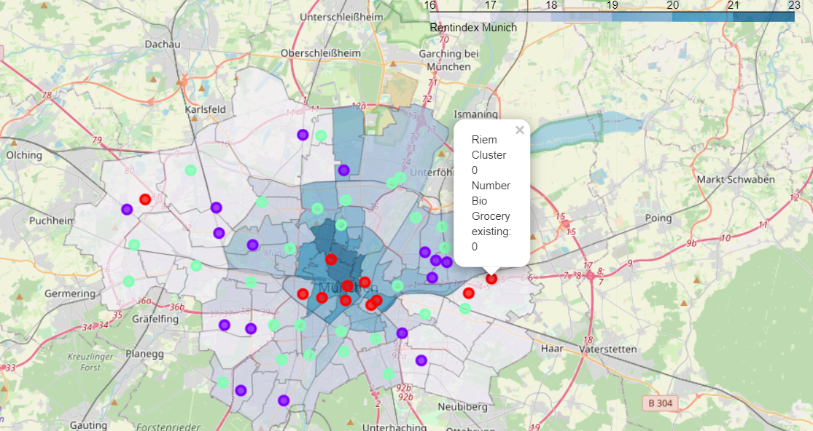
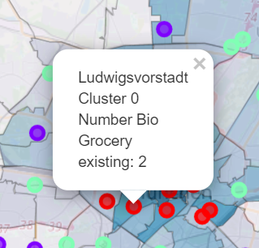
Clustered neighborhoods with visualized rent index of Munich
Cluster 0 : - City center - Venues for nightlife, relaxation and holiday - higher rents - less Markets or Bakeries
Cluster 1: - outer parts - Bus stop and markets - rents are lower.
Cluster 2: - ring around the center of the city - physical health - markets and drugstores - rents middle

Slide 8
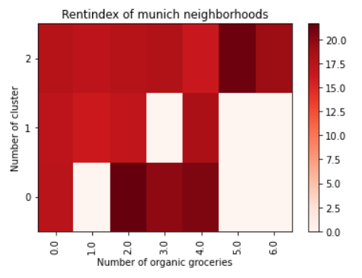
Relationship: Rent index --- prevalence of organic groceries
Less organic groceries are in in areas with lower rent
In Cluster 0 and 2: more organic groceries are in neighborhoods with higher rents.
Recommendation for the place of an organic grocery
Cluster 2:
Venues are geared for daily needs
Rent are in the middle -> people can afford organic food
about ½ of the neighborhoods have no organic grocery
No recommendation: Cluster 0: central, expensive, venues for recreation
Cluster 1: cheaper rents, a lot of markets, almost no organic grocery, people might have less money

Slide 9
This study might be useful for investors or city planners, who might be interested in making a city more attractive.
Sources:
[1]https://de.wikipedia.org/wiki/Liste_der_Stadtteile_M%C3%Bcnchens
[2] https://www.suche-postleitzahl.org/plz-karte-erstellen
[3]https://de.statista.com/statistik/daten/studie/260438/umfrage/mietpreise-in-muenchen-nach-bezirken/#professional
[4] https://www.suche-postleitzahl.org/muenchen-plz-80331-85540.52bb
[5] https://geopy.readthedocs.io/en/stable/
[6] https://foursquare.com/
[7] https://www.dasoertliche.de/
Picture Munich https://www.pexels.com/

